Slide 1
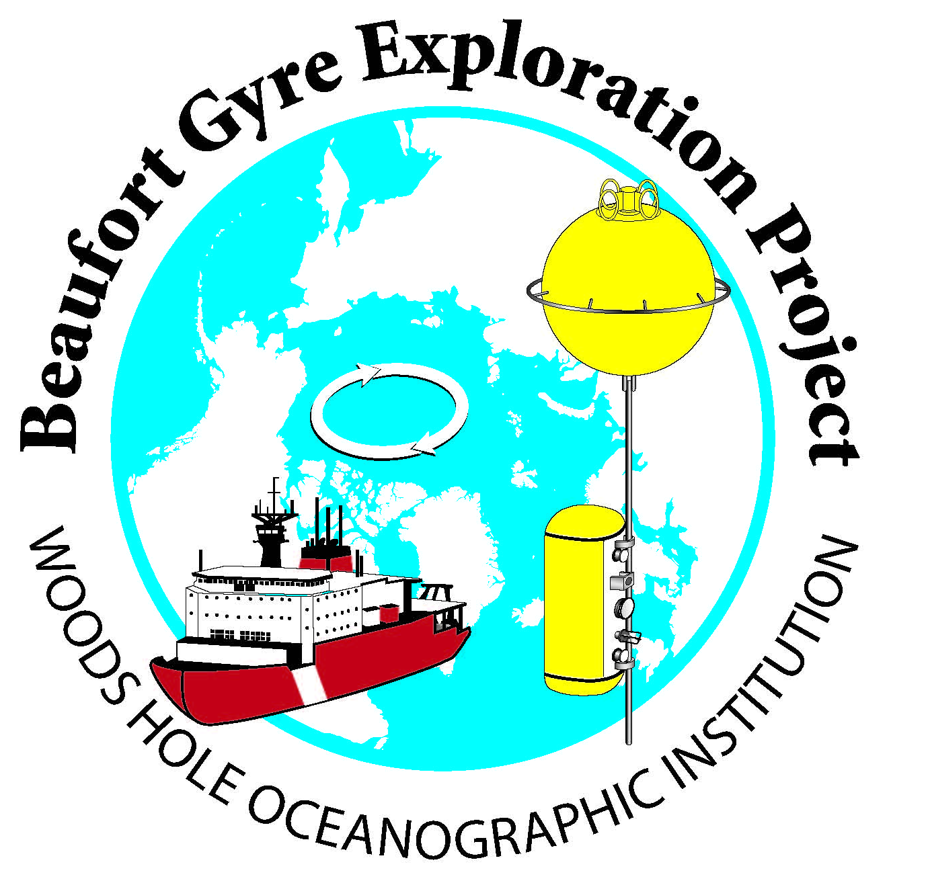


Status of the Beaufort Gyre
Observing System
(BGOS, 2003-2015)
Andrey Proshutinsky, Woods Hole Oceanographic Institution, USA
Richard Krishfield, Woods Hole Oceanographic Institution, USA
John Toole, Woods Hole Oceanographic Institution, USA
Mary-Louise Timmermans, Yale University, USA
Bill Williams, Institute of Ocean Sciences, DFO, Canada
Eddy Carmack, Institute of Ocean Sciences, DFO, Canada
Fiona McLaughlin, Institute of Ocean Sciences, DFO, Canada,
Koji Shimada, Tokyo University of Marine Science and Technology, Japan
Robust Autonomous Arctic Observations: Successes and Challenges
18 November 2015
2:00 – 2:15 pm
2015 Arctic Observing Open Science Meeting
Seattle, Washington, USA

Slide 2
BGOS: Funding history
2003-2004: Beaufort Gyre Freshwater Experiment: Study of fresh water accumulation and release mechanism and a role of fresh water in Arctic climate variability – NSF
2004-2005: Beaufort Gyre Freshwater Observing System – WHOI
2005-2009: The Beaufort Gyre System: Flywheel of the Arctic Climate? – NSF
2009-2014: AON: Continuing the Beaufort Gyre Observing System to Document and Enhance Understanding Environmental Change in the Arctic – NSF
2015-2018: AON – Continuing the Beaufort Gyre Observing System to Document and Enhance Understanding of the Beaufort Gyre Freshwater Reservoir Transformations and Fate – NSF

Slide 3
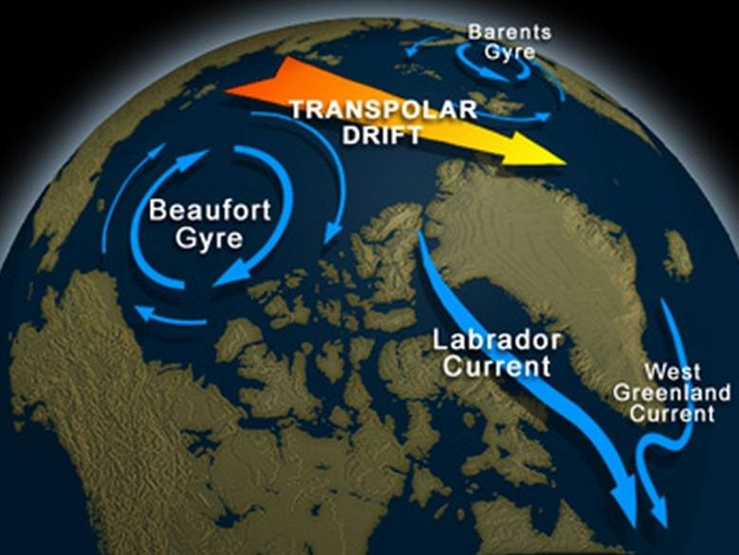
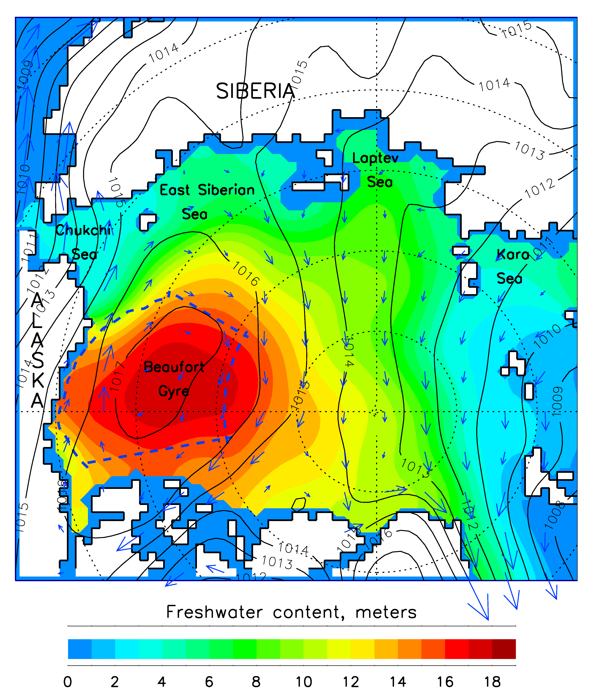
Beaufort Gyre circulation cell and freshwater reservoir
Greater than half of the total Arctic Ocean’s liquid fresh water is stored in the Canada Basin with its Beaufort Gyre (BG) which contains more than 20,000 km³ of liquid fresh water (i.e. Aagaard and Carmack, 1989).
The volume of freshwater in the BG is practically identical to the volume of fresh water in Lake Baikal (23,000 km³), the largest lake on the Earth, and is comparable with fresh water volume stored in all Great Lakes (23,000 km³). The BG volume is at least 5 times larger than the total annual river runoff to the Arctic Ocean and approximately two times larger than the volume of fresh water stored in Arctic sea ice .
The BG has a capability to impact climate releasing large volumes of freshwater to the Labrador and Nordic Seas and inhibiting deep convection there, that may reduce intensity of the ocean meridional overturning circulation and result in climate cooling.

Slide 4

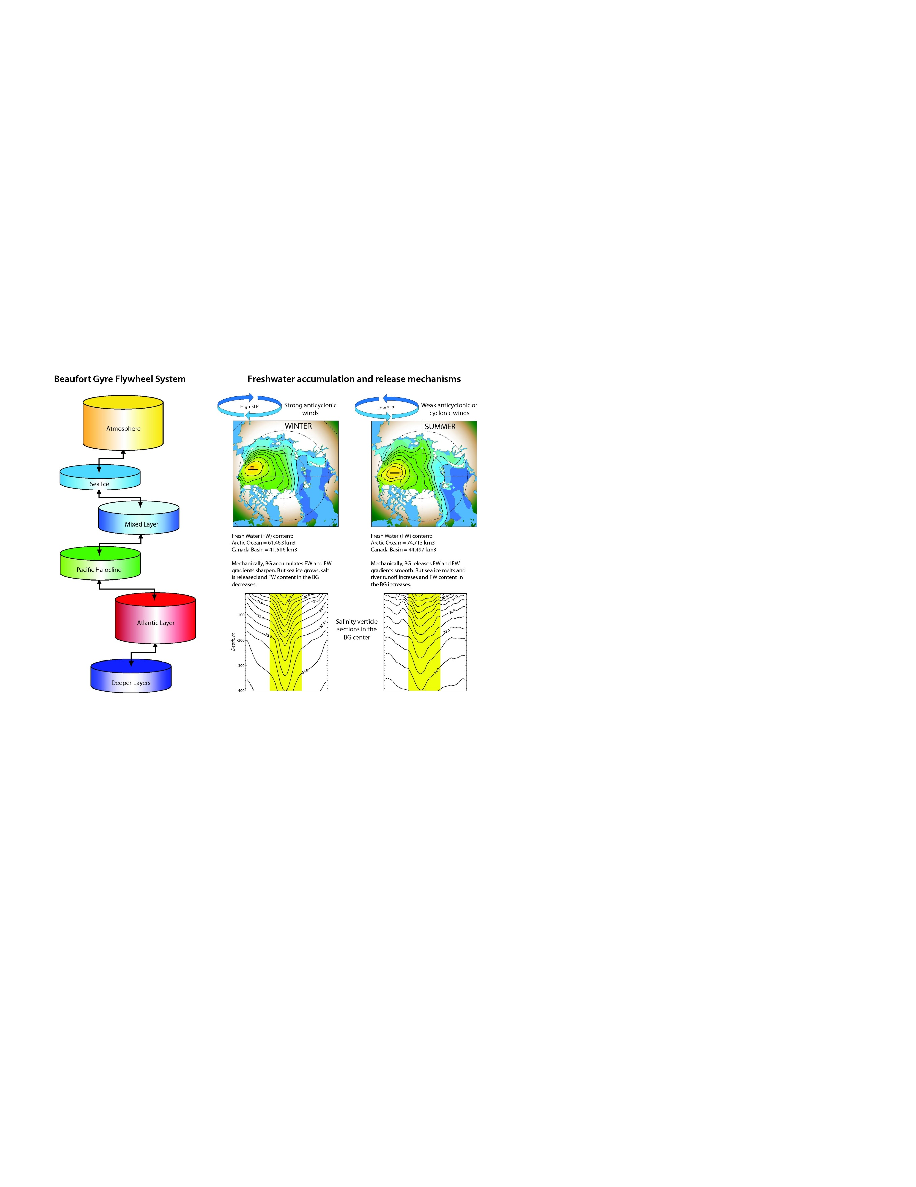
Questions and Hypotheses
What is the origin of the salinity minimum in the BG?
How does this salinity or freshwater content change in time?
What are the driving forces of the BG circulation and how stable is the BG system?
Proshutinsky et al. [2002] hypothesized that the BG collects freshwater in its center under anticyclonic winds due to convergence of Ekman transport and subsequent Ekman pumping; and releases it when wind weakens or changes sense
to cyclonic and the Ekman transport convergence reduces or changes to divergence, respectively.

Slide 5
Beaufort Gyre Observing System (BGOS)
In order to test this hypothesis, the BG Observing System (BGOS) was established in 2003 as a part of the Beaufort Gyre Exploration Project.
Later, this project has been continued and expanded because of importance of the BG freshwater reservoir for climatic changes in the Arctic and Sub-arctic regions.
The BGOS was designed to observe and investigate year-round and long-term changes associated with freshwater and heat fluxes in the entire BG climate system at standard locations measuring all possible water, ice and environmental parameters which can explain fresh water transformations (liquid and solid) and changes under variable sources and forcing.

Slide 6
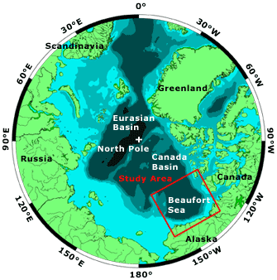
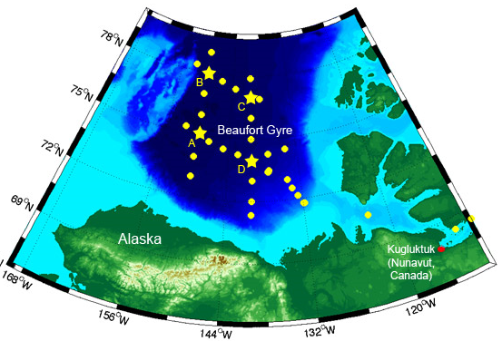
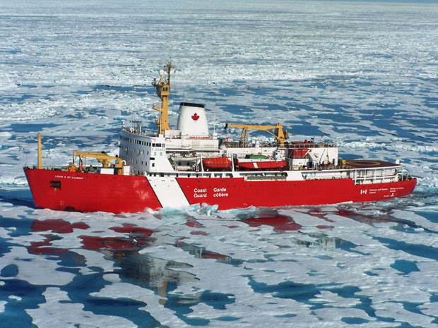
BGOS: geography and standard observational sites
2003 -2018
Standard mooring (stars) and CTD (circles) sites
Canadian Coast Guard icebreaker
Louis S. St. Laurent

Slide 7
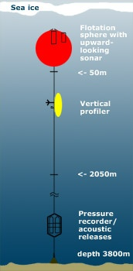
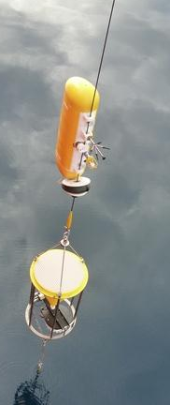
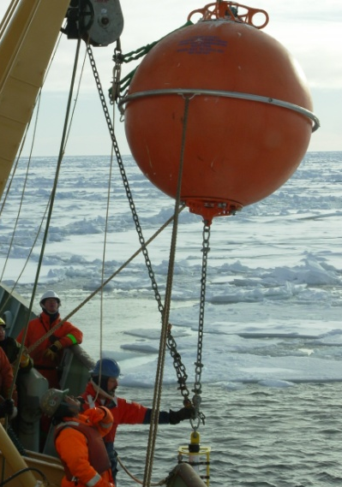
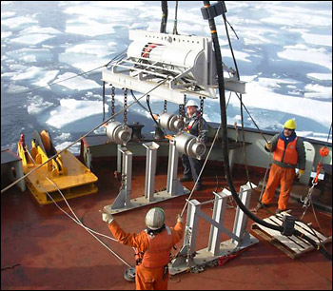

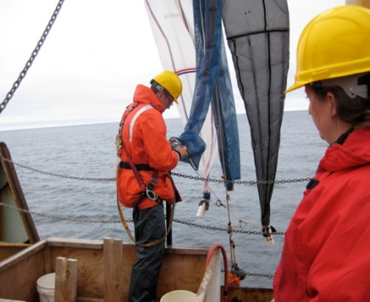

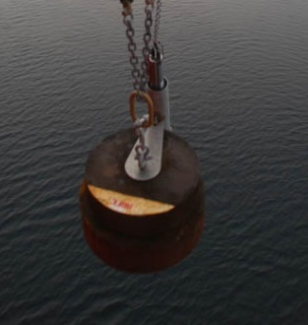

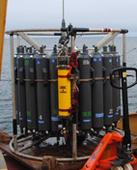

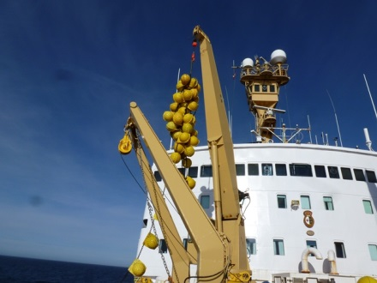
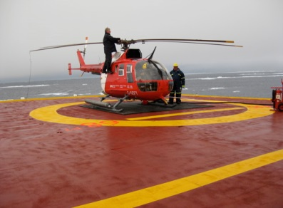
BGOS: Instrumentation
McLane
Moored
Profiler
Sediment
trap
Seismic work
Upward-looking sonar
Bongo nets
Ice-Tethered Profiler
ADCP
BPR
CTD

Slide 8
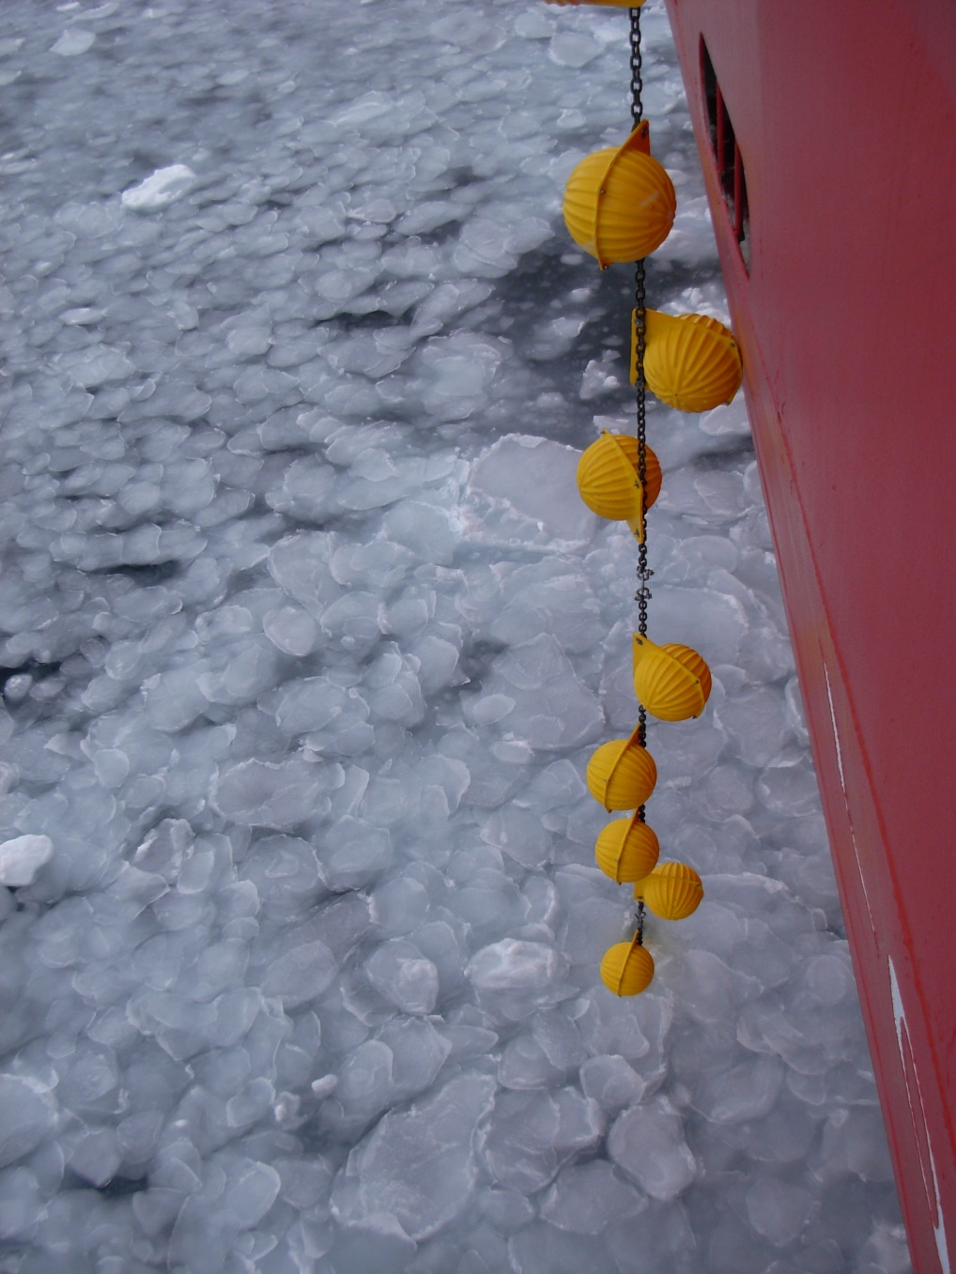
BGOS deployments/recoveries
Year | CTD | XCTD | ITP | IMB | AOFB | O-buoy | Moor-s
2003 | 47 | 84 |  |  |  |  | 3
2004 | 36 | 80 | 1/0 | 1/0 |  |  | 3/3
2005 | 51 | 43 | 2/0 | 2/0 |  |  | 5/3
2006 | 75 | 55 | 3/0 | 2/0 | 2/0 |  | 4/5
2007 | 105 | 74 | 3/2 | 1/0 | 2/0 |  | 4/4
2008 | 73 | 104 | 5/0 | 1/0 | 2/0 |  | 3/4
2009 | 53 | 56 | 4/2 | 1/0 | 1/0 | 1/0 | 3/3
2010 | 72 | 59 | 4/1 | 2/0 | 2/0 | 1/1 | 3/3
2011 | 52 | 49 | 3/0 | 3/0 | 3/0 | 1/0 | 3/3
2012 | 56 | 108 | 4/0 | 3/0 | 2/0 | 2/0 | 5/4
2013 | 52 | 88 | 4/0 | 3/0 | 2/0 | 1/0 | 5/5
2014 | 40 | 65 | 2/3 | 2/0 | 2/0 | 2/0 | 3/3
2015 | 70 | 54 | 2/0 | 2/0 | 1/0 | 2 | 3/4
Total | 782 | 919 | 37/8 | 23/0 | 20/0 | 10/1 | 47/45

Slide 9
University of Laval, Quebec City, Quebec, Canada
BGOS: measured
parameters
Standard
1. Ocean physical parameters: T, S, currents, bottom pressure
2. Sea ice: Draft, drift
3. Biogeochemistry: CFC, O2, TCO2, 13C, DOC, Helium & Tritium, 14C, Nutrients, 18-O, Ba, Iodine, Cesium, Chla-T, Chla-10/2, POC, C-DOM, CHO, HCH
Non-standard by other programs using BGOS logistics
Lowered ADCP
Sediment traps
Zooplankton sampling
Sea ice physical and chemical properties
Wildlife observing
Seismology
Turbulence measurements
Buoys: Up-Tempo, IMBs, O-buoys, AOFB, ITPs, SAMs – IBOs, polar profiling floats
Drift bottles
Media filming

Slide 10
University of Laval, Quebec City, Quebec, Canada
BGOS:
other participants
USA institutions
Yale University, New Haven, US
Bigelow Laboratory for Ocean Sciences, USA
Cold Regions Research Laboratory, USA
Lamont Doherty Earth Observatory, USA
University of Rhode Island, USA
Pacific Marine Environmental Laboratory, NOAA, USA
Oregon State University, USA
Pacific Marine Sciences and Technology LLC, USA
University of Alaska Fairbanks, USA
University of Akron, Akron, USA
University of Montana, Missoula, USA
International Arctic Research Center, USA
Naval Postgraduate School, USA

Slide 11
University of Laval, Quebec City, Quebec, Canada
BGOS:
other participants
Canada institutions
University of Victoria, British Columbia, Canada
Natural Resources Canada
University of Laval, Canada
Trent University, Peterborough, Ontario, Canada
University of British Columbia, British Columbia, Canada
University of Montreal, Montreal, Quebec, Canada
Institute of Ocean Sciences, DFO, Canada
Environment Canada

Slide 12
University of Laval, Quebec City, Quebec, Canada
BGOS:
other participants
Japan institutions
JAMSTEC, Japan
Tokyo University of Marine Science and Technology, Japan
Weathernews Inc., Mihama, Chiba, Japan
Kitami Institute of Technology, Kitami, Hokkaidō, Japan
UK institutions
SAMS Scottish Association for Marine Science, UK
The Environment of the Arctic – Climate, Ocean and Sea-Ice, UK
3. Bangor University, Wales, UK
China institutions
1. Ocean University China, China

Slide 13
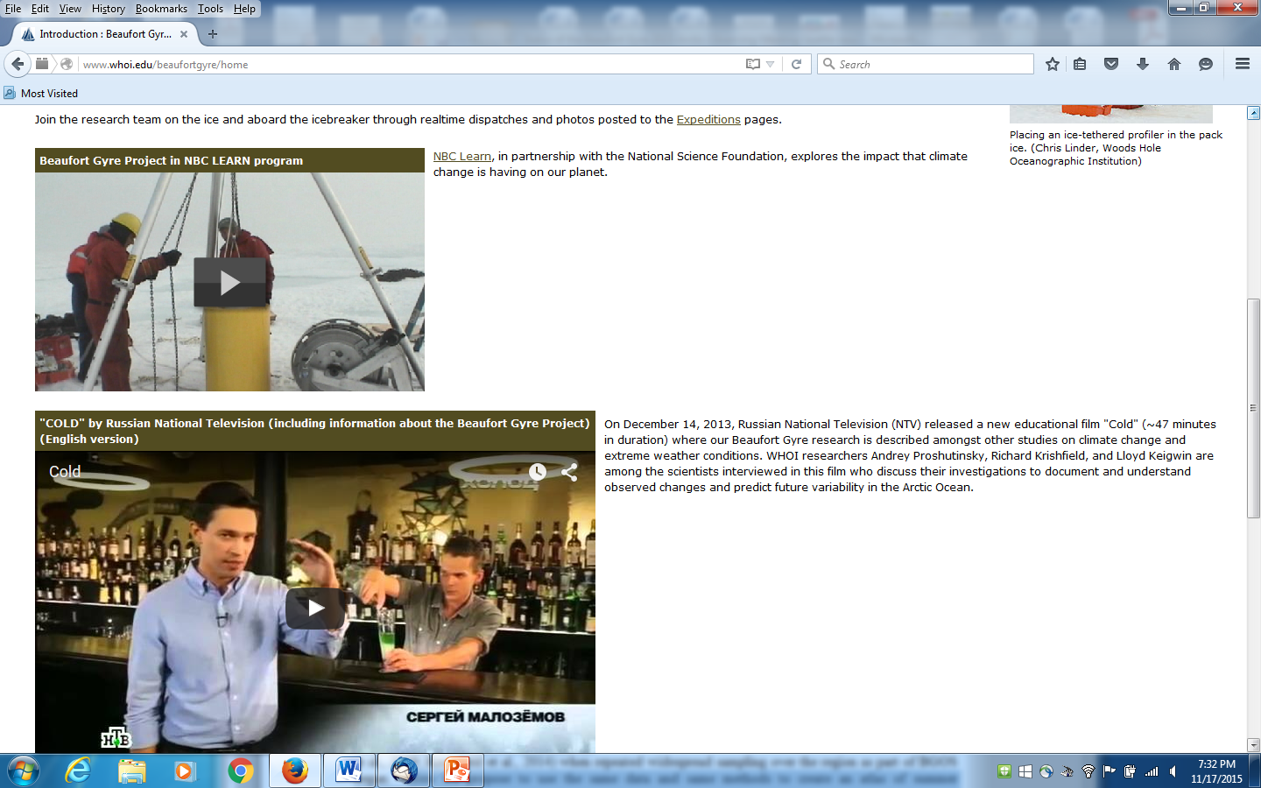
University of Laval, Quebec City, Quebec, Canada
BGOS:
other participants
Poland institutions
Institute of Oceanology, Poland
Korea institutions
1. KOPRI Korea Polar Research Institute, Korea
Media relations
ABC Asahi Broadcasting Company, Japan
Educational Broadcasting System (EBS), Korea
National Broadcasting Company (NBC)
National Television, NTV (Russia)

Slide 14
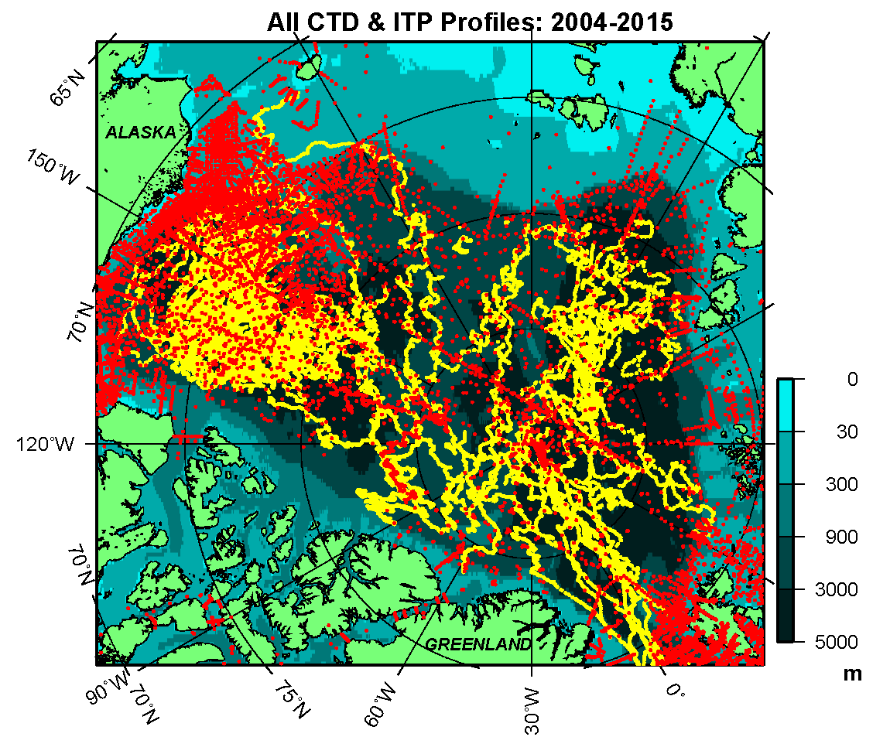
BGOS: multi-institutional/disciplinary logistics/platform

Slide 15
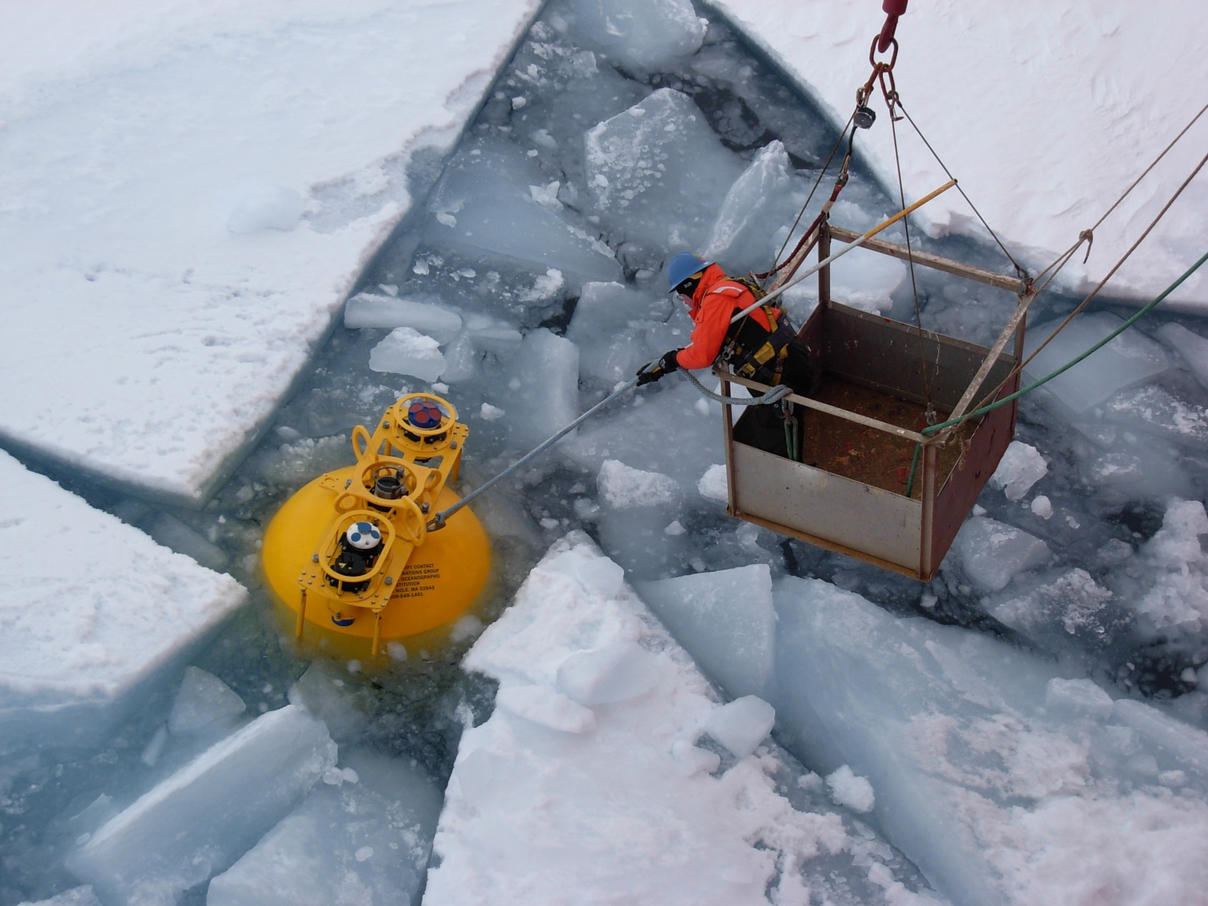
BGOS major results:
publications
The first program results for 2003-2007 were published in JGR special section “Beaufort Gyre Climate System Exploration Studies” (JGR Oceans, vol. 115, no. C1, 2010).
To date, over 80 peer-reviewed publications have utilized BGOS data.

Slide 16
BGOS major findings
Hydrography: Hydrographic data indicate that liquid fresh water in the BG in summer increased 5410 cubic km from 2003 to 2010 and decreased a bit in 2011-2014 but in 2015 it reached it absolute maximum of 22,600 cubic km or 5600 cubic km over climatology of the 1950s-1980s.
Sea ice: Negative trends in ice drafts are observed, while open water fraction have increased, attesting to the ablation or removal of the older sea ice from the BG over the observational period. A shift occurred toward thinner ice after 2007. (Krishfield et al., 2014)

Slide 17
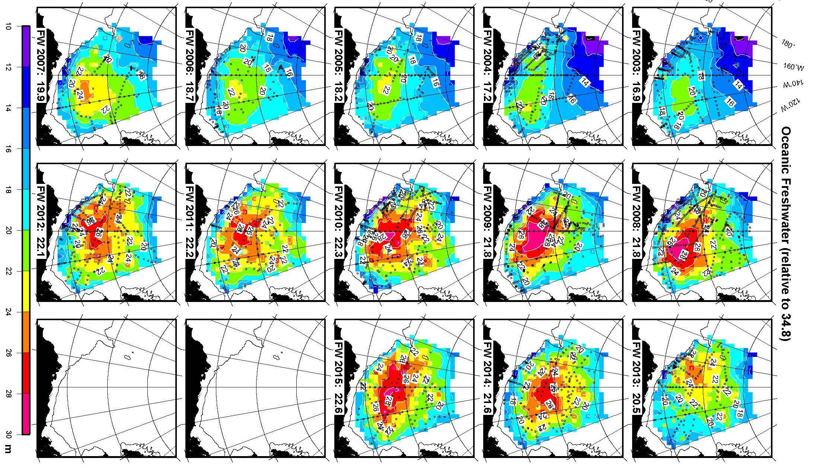
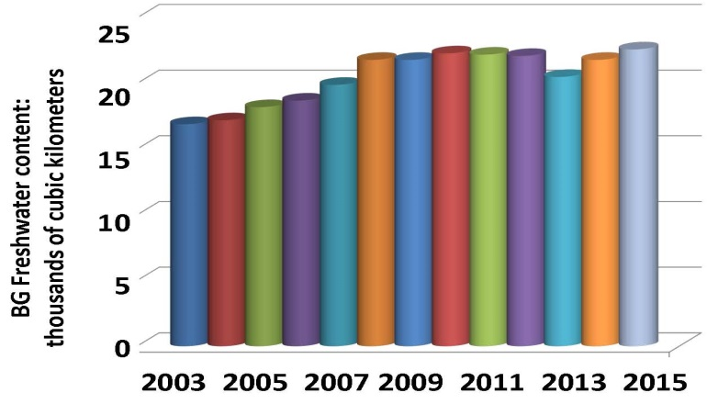
BGOS major results:
Freshwater

Slide 18
BGOS major results:
Freshwater
– Annual river runoff to the Arctic Ocean
25
20
15
10
5
0
BG Freshwater content:
thousands of cubic kilometers
2003 2005 2007 2009 2011 2013 2015

Slide 19
BGOS major results:
Freshwater
25
20
15
10
5
0
No ice data yet
BG Freshwater content:
thousands of cubic kilometers

Slide 20
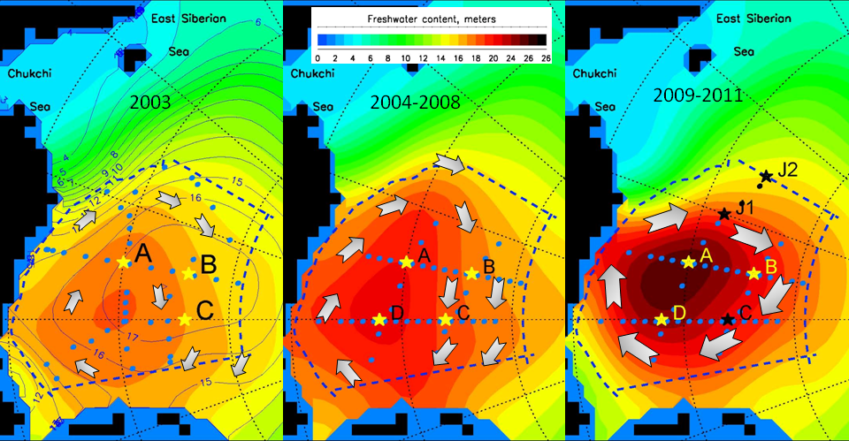
BGOS major results:
Circulation
see Proshutinsky et al., 2009; McPhee et al., 2009; McPhee, 2013

Slide 21
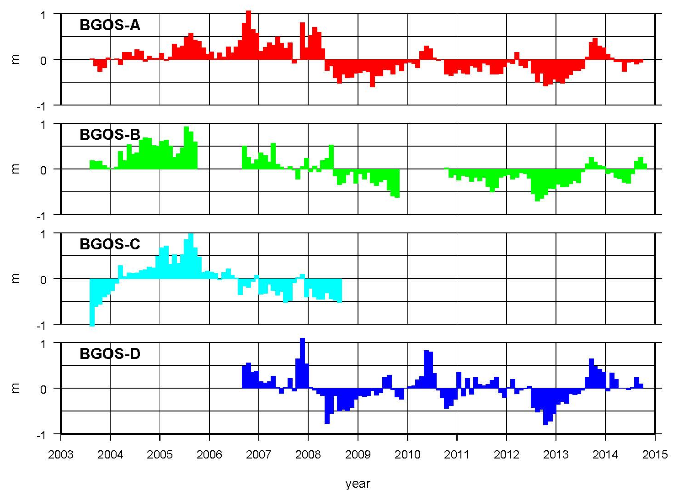
BGOS major results:
Ice draft
Ice draft anomalies, meters
Negative trends in ice drafts are observed, while open water fraction have increased, attesting to the ablation or removal of the older sea ice from the BG over the observational period.
A shift occurred toward thinner ice after 2007.
(Krishfield et al., 2014)

Slide 22
BGOS major findings: Geochemistry
Freshwater composition: During the rapid increase in BG freshwater content over 2005-2007 sea-ice meltwater increased by 2.7 m in the central BG region and low-salinity water from the Mackenzie River was advected to the southern BG region. (Yamamoto-Kawai et al., 2009a)
Ocean acidification: Surface waters of the BG became undersaturated with respect to aragonite in 2008 - the first sign of acidification in the global deep ocean (Yamamoto-Kawai et al., 2009b). Three factors contributed: reduced sea-ice extent (~30%), increased sea-ice melt (~30%), and anthropogenic CO₂ (~40%). The deeper Pacific Winter Water is also undersaturated, due to anthropogenic CO₂, with negative implications for shelled benthic organisms during upwelling to shelf ecosystems (Mathis et al., 2011).

Slide 23
BGOS major findings: Geochemistry
Organic carbon cycle: Hwang et al. (2008) analyzed sediment traps at BGOS mooring A, finding that, unlike other ocean basins, the bulk of particulate organic carbon entering the deep BG region is supplied by horizontal advection from the surrounding margins and that both the organic and inorganic carbon cycle in the Arctic is inherently linked to ocean dynamics.
Ecosystem Effects: McLaughlin and Carmack (2010) noted that FW changes from 2007 to 2009 in the BG depressed the top of the halocline and increased the stratification there by 25%, thus deepening the upper nutricline and associated summertime subsurface chlorophyll maximum and making nutrients less available. These harsher conditions coincided with a shift in near-surface ecosystem structure towards the smallest plankton (Li et al., 2009).

Slide 24
BGOS: other observations
Michael DeGrandpre (Department of Chemistry and Biochemistry University of Montana asked me to show you these results (left figure) from moorings recovered in October 2015 BG cruise. pCO2 sensor was located at 37m depth at mooring B and pH sensor at Mooring.
It is assumed the big pCO2 swings at mooring B are due to eddies. These are also collected within the halocline (not in the mixed layer) and so have variability due to that, although not as evident under ice.
The pCO2 begins to drop in early May, presumably due to biological production. The slight warming would increase the pCO2 slightly, so the production is counteracting that.

Slide 25
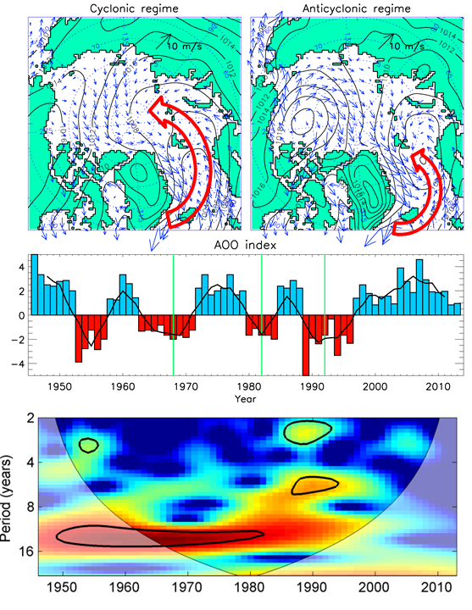

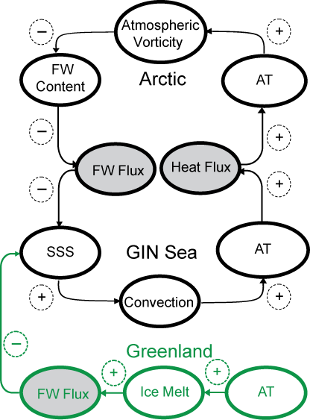
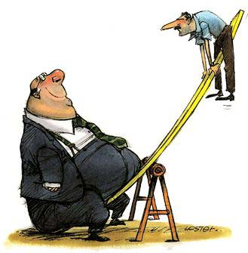
BGOS Future Justification: Hypothesis – Circulation Regimes
Arctic FW
Sub-Arctic heat
1946-1996 decadal oscillation
Greenland FW
1997-2015: 17 year of ACCR
We speculate that longer duration ACCRs could result in Arctic cooling accom-panied by increased ice extent and thickness—similar to conditions observed in the 1970s. (see Proshutinsky et al. (2015) Arctic circulation regimes, Philosophical Transactions A of Royal Society; in “Arctic sea ice: the evidence, models and impacts”, doi.org/10.1098/rsta.2014.01600

